Slide 1
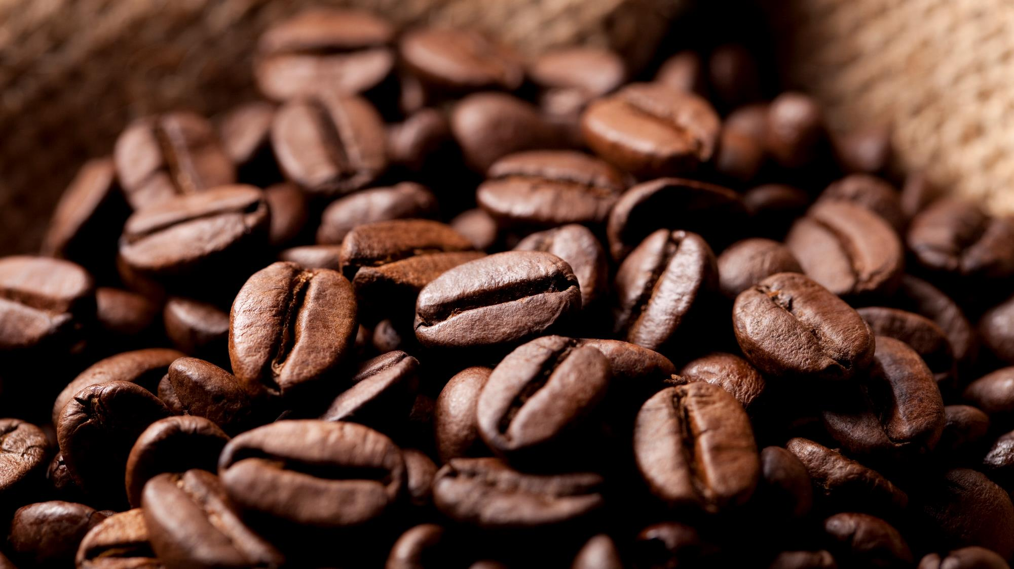
BRIGHT Coffee SHOP
Sales Analysis
Presentation

Slide 2
Contents
Introduction
Revenue Made
Revenue per Month
Day and Time Groupings
Number of Sales per Month
Day Revenue
Time Buckets
Charts for Category Revenue
Stores and Category Performance
Product Performance per Store
Recommendations
Conclussion

Slide 3
Introduction
The new CEO at Bright Coffee Shop is looking to lead the company to new direction to increase revenue and improve product performance, such decisions will made after looking into the following:
Highlighting revenue made by the Bright Coffee, how did each of their 3 stores performed. The products that performed better compared to others.
Look into time and day store performance
Sales trends across products and time intervals
And then, make recommendations to the CEO oh how the can improve sales performance

Slide 4
Revenue Made for The Period
For the period under review of 6 months, the company has made a total revenue to the amount of:
R698 812.33

Slide 5
Coffee, Tea and Bakery are the 3 Categories generating the most revenue for the coffee shop we see below with R269952.45, r196405.95 and R82315.64 Respectively. The Worst performing Categories amongst the 9 That the company have Flavours(R8408.80), Packaged Chocolate(R4407.64) and Loose Tea(R11213.60) are them.

Slide 6
Coffee and Tea has been the best performing Category across all the stores followed by both Bakery and Drinking CHOCOLATE THE Three Lowest performing Categories ARE Branded, Packaged Chocolate and Loose TEA COFFEE BEANS AND flavours have been performing bad as well but there is room for IMPROVEMENT

Slide 7
The month of June followed by MAY WERE THE BEST PERFORMING MONTHS, WHICH MIGHT BE AFFECTED BY DIFFERENT FACTORS RANGING FROM WEATHER, THE WINTER SEASON, AND more people focusing on hot Beverages February was the lowest month were revenue was made as it was the summer months and is one of the hottest months in the summer season in the country

Slide 8
The Coffee SHOP IS MAKING Less Revenue in The evenings both on weekdays and Weekends. Morning Times on Weekdays and Weekends have been the Most profitable Periods for the company, mornings have been the time where the company is making MORE Sales with revenue of R280 078.35. The Evenings WITH revenue of R29 468.15 on weekends and R76334.68 ON WEEKDAYS are the least period in terms of business.

Slide 9
January and February were the lowest months in Sales for the shop ,REASONS Could BE that Most people are still not back to work or slowly going back to work. May and June as it was the winter season the Sales made were high during the weekdays as people are going to work which is linked to high morning sales IN June. The Weekends have been performing low but not bad as it is consistent across the period except for APRIL as that was the month most sales were made on a weekend.

Slide 10
The company has been doing well in Sales made in the morning, ranging around R50000 on weekdays. The afternoons have been consistent on the R30000 mark but Tuesdays seem to be days that the company is not performing well

Slide 11
Hell’s Kitchen IS The company’s high performing store or location with 21 932 sales made for the period UNDER REVIEW. The Store located in ASTORIA IS THE SECOND PERFORMING STORE FOR BRIGHT COFFEE SALES RECORDED TO BE 21557, FOLLOWED BY LOWER MANHATTAN. These performance could be influenced by different things like where its located WHERE There is a small population or far from people like at a Garage.

Slide 12
Trends Analysis
Coffee and Tea are the two categories to perform well for the company across summer to winter times from morning to evenings.
Packaged Chocolate performed bad through out all the stores with 104 (at Astoria), 155 (at Lower Manhattan), 187 (at Hell’s Kitchen).
Bakery and Coffee are the best sellers in the following time intervals (Mornings, Afternoon, and Evenings)
The has been growing trajectory when the months start moving to the winter seasons as hot the beverages are selling better and the baked product also hold that trend
The winter months seem to be where the company was performing well in both weekdays and weekends as well.
The Lower Manhattan store is the least performing store across all three locations the company has.

Slide 13
Recommendations
The company should do promotional runs on low performing products like Traditional Blend Chai, Peppermint, Jamacian Coffee River and get a points that can be used to buy with when they reach 50points.
Place discounts on slow moving time intervals like the evenings on selected products like Loose Tea and Packaged chocolates
In the summer months there should be competitions runs where the conditions to enter is by buying the slow product and at the Lower Manhattan location.
There should be a review at the store not performing about staff size, store design and customer awareness to review if people are aware that the company has another branch there.
Drop the prices of the of the product that are not moving of the shelves of the store
Try to repackage the product not being sold or selling at the slowest rate with the one customer are buying like Packaged Chocolate be included in some coffee products.
The company should also consider stop selling some of the products not doing well on both weekdays and weekends.

Slide 14
CONCLUSION
In reviewing the company historical data, it is important that we see that the business in doing okay in some aspects like Coffee, Tea and Bakery. Also Hell’s Kitchen is the company’s most profitable location as well the morning time bucket. Therefore it is worth noting that work can be done on Flavours and drinking chocolate to improve selling, and that it’s okay to discontinue some products that are profitable.

Slide 15


Thank You
Email BrightCoffee@Org.com

